Slide 1
Stochastic resonance in Hodgkin-Huxley model
物理19 鄭力珊 物理20 黃紹倫
物理20 李展誼 物理20 葉百祥

Slide 2
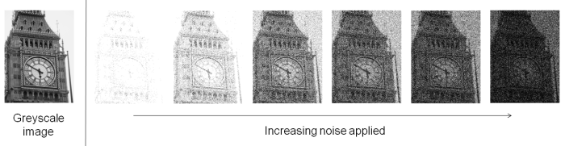
Introduction of stochastic resonance
In most of the case, noise is something we want to avoid. However, if the strength of signal is close to the sensor threshold, adding specific amount of noise can counterintuitively improve SNR. This phenomenon is called stochastic resonance.

Slide 3
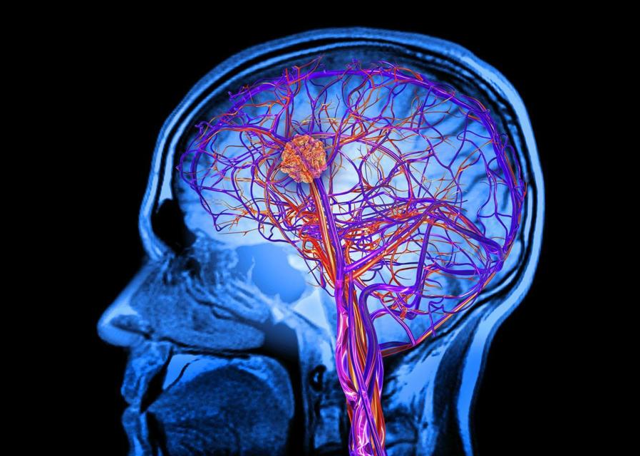
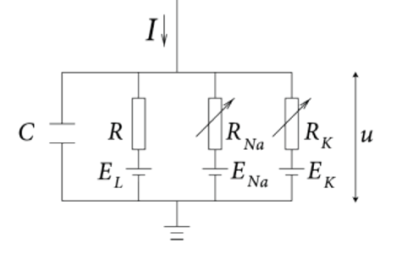
Introduction of stochastic resonance
Electromagnetic
Physical
Biological

Slide 4
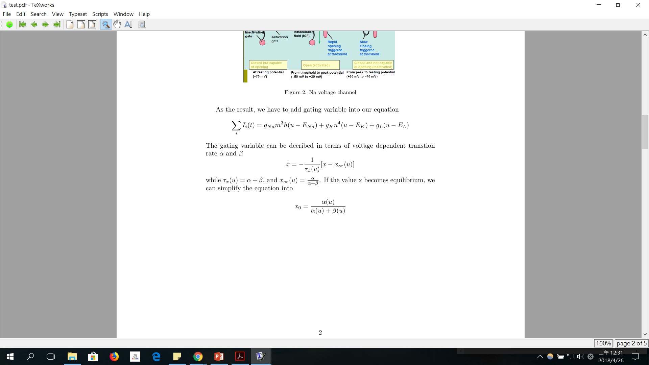
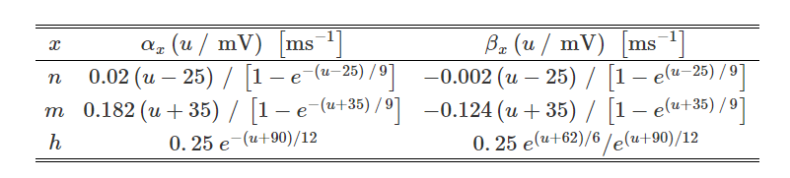
Introduction of HHmodel

Slide 5
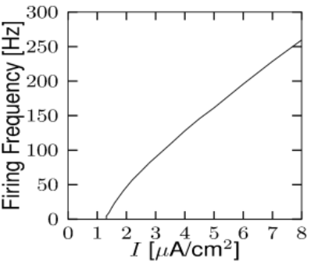
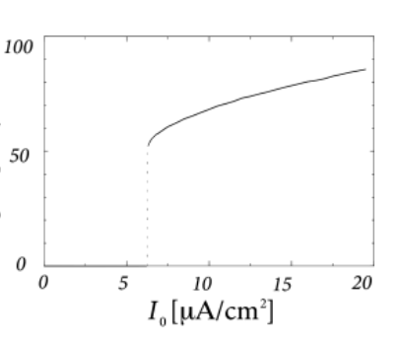
Type I and Type II neuron

